Slide 1
COVID-19 Effects on Public School Education Performance
Team 9

Slide 2

Introduction
COVID-19
Originated in 2019 in China
Changed public healthcare, the food industry, transportation, and education

Slide 3

Introduction
STAAR or The State of Texas Assessments of Academic Readiness
Grades 3-12
Reading, Science, Social Studies, Math
Four performance categories: “Did Not Meet Grade Level”, “Approaches Grade Level”, “Meets Grade Level”, and “Masters Grade Level”

Slide 4

Introduction
Modifications to Education
Social distancing
In-person to online to hybrid
New softwares
Change in Academic Performance
Digital Divide

Slide 5
Previous Literature
Bozkurt et al. (2022) identified three academic disruptions from pandemic:
Education Crisis, Mental Health Issues, Increase in Online Learning
Led to learning halt, lower test scores, feelings of isolation, anxiety, etc.
Burkholder and Salehi (2023) found difference in effect by racial group:
"first-generation students in STEM suffered more from the alterations in secondary instruction"
Foreign-born and minority students suffered more significant decline than native caucasian counterparts
Authors do not discuss why, just identify reality

Slide 6
Previous Literature
Multiple studies find math performance is affected most by pandemic
Kuhfeld et al. (2022): 2021 math scores approximately 0.2 standard deviations lower than 2019
Dorn et al. (2021): Average student fell five months behind grade level in math, four months behind in reading
Bailey et al. (2023): Pandemic affects students from low-income families
Low-income students on average fall behind extra half year from others
Di Pietro (2023): Average academic loss ~ 0.19 standard deviations
Comparable to effect of Hurricane Katrina (Sacerdote, 2012)

Slide 7
Initial Data Discussion
School-level data as unit of observation
Data from ~9,000 school, ranging from over 1,200 school districts
Omitted data from schools that had missing information and abnormal values
For the remaining schools, we split up exam scores by ethnicity,
Shows which ethnicity succeeded or struggled the most from pandemic
After splitting up by ethnicity, we then omitted smaller ethnic groups
Did not have significance in the model
Notes:
Adam

Slide 8
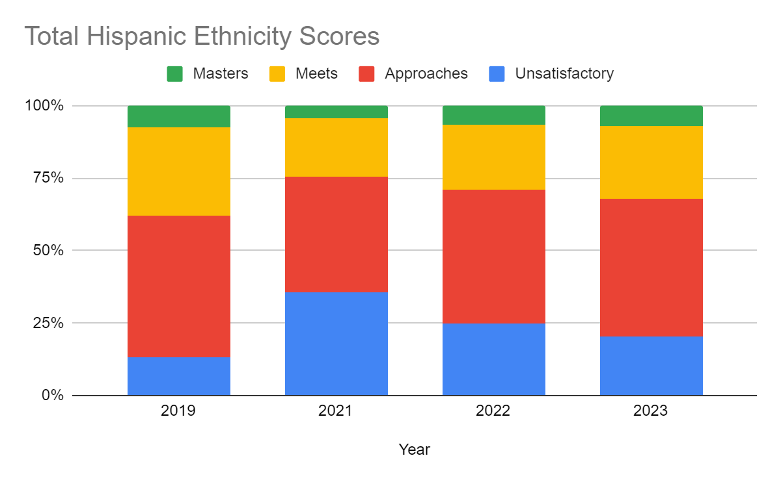
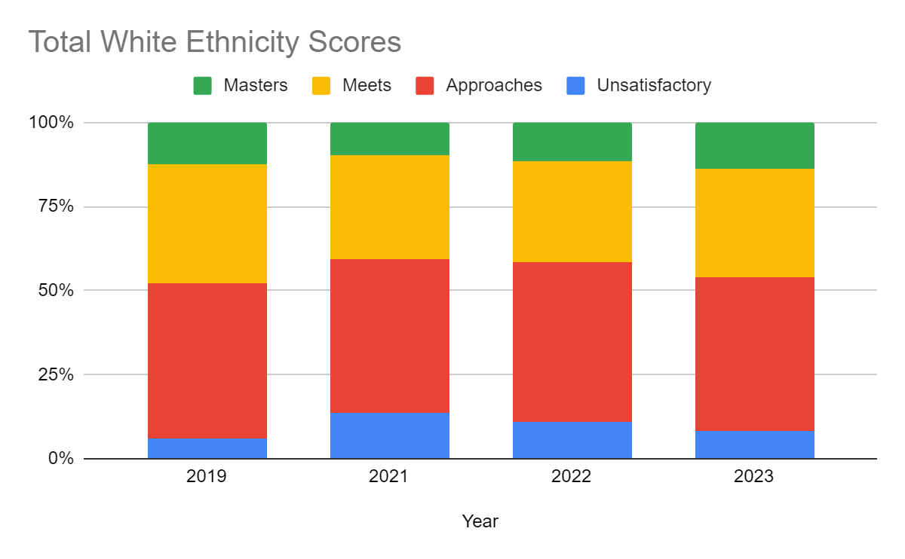
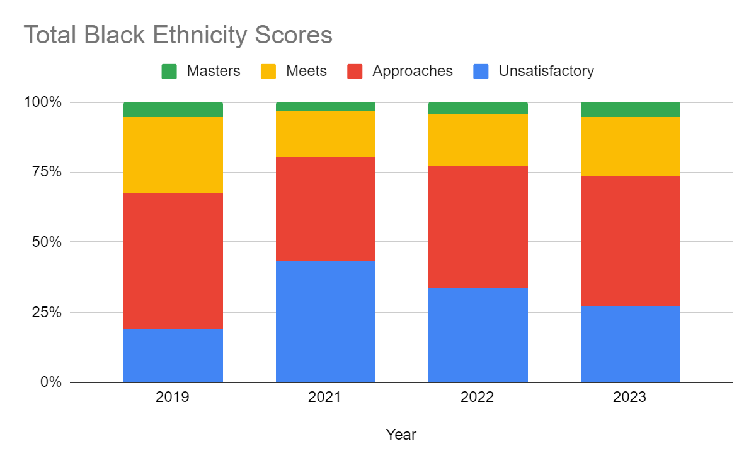
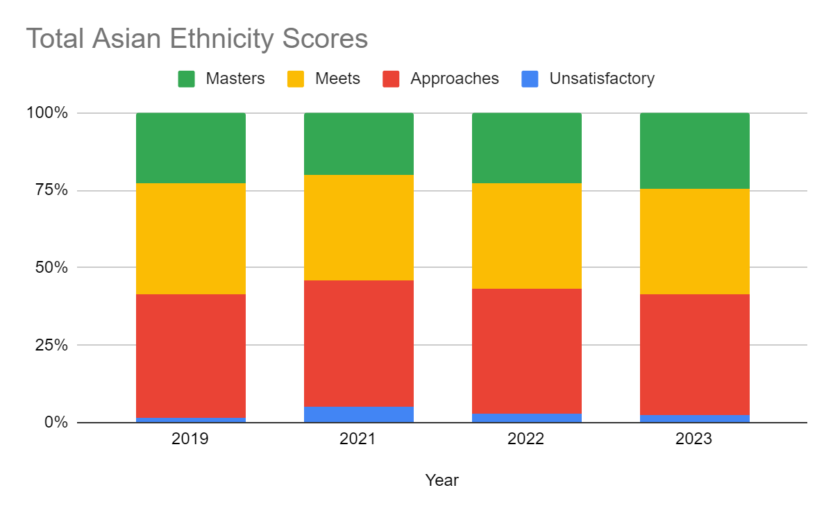
Initial Data Discussion
Notes:
Adam

Slide 9
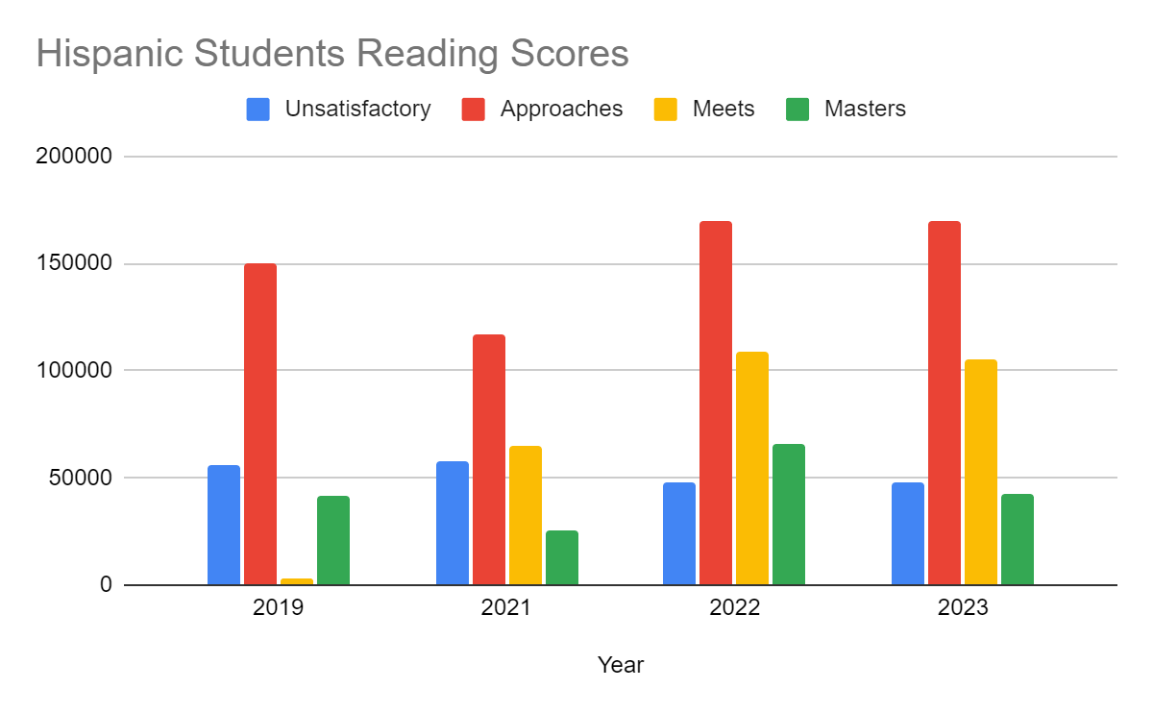
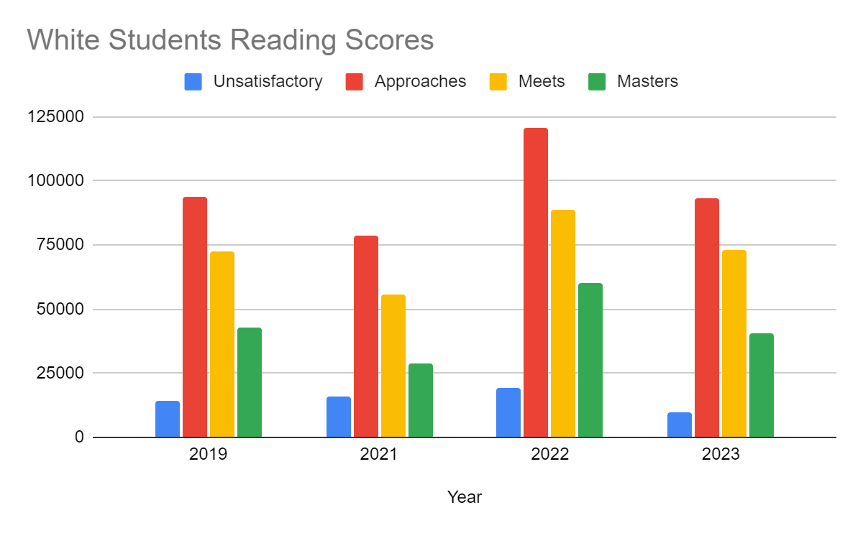
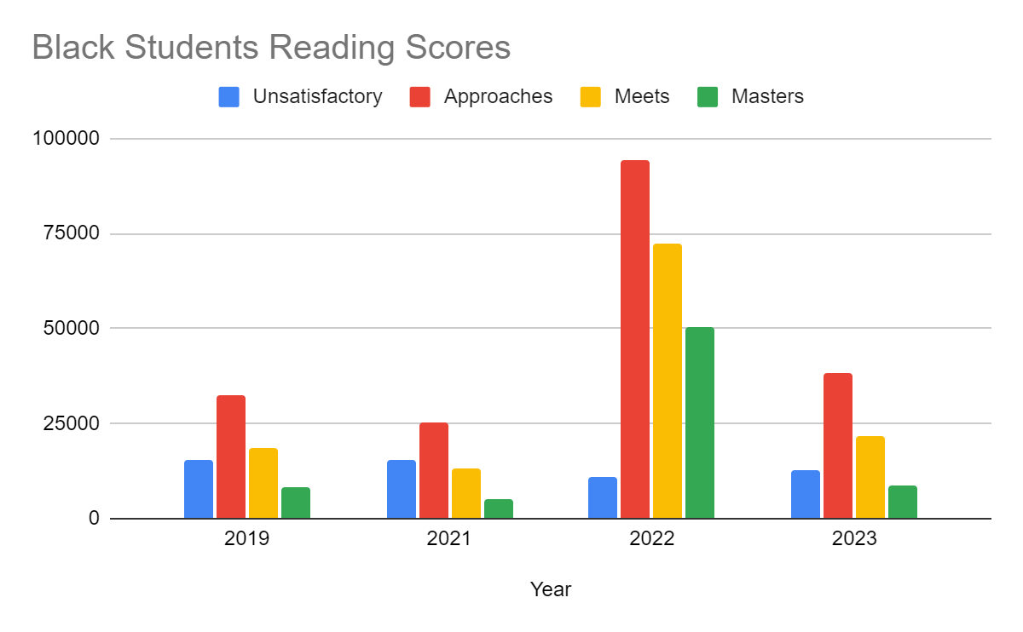
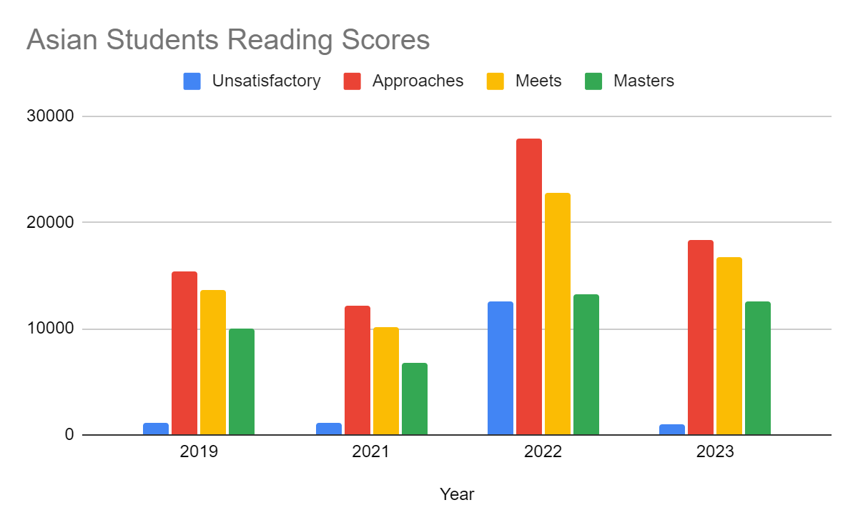
Reading Findings

Slide 10
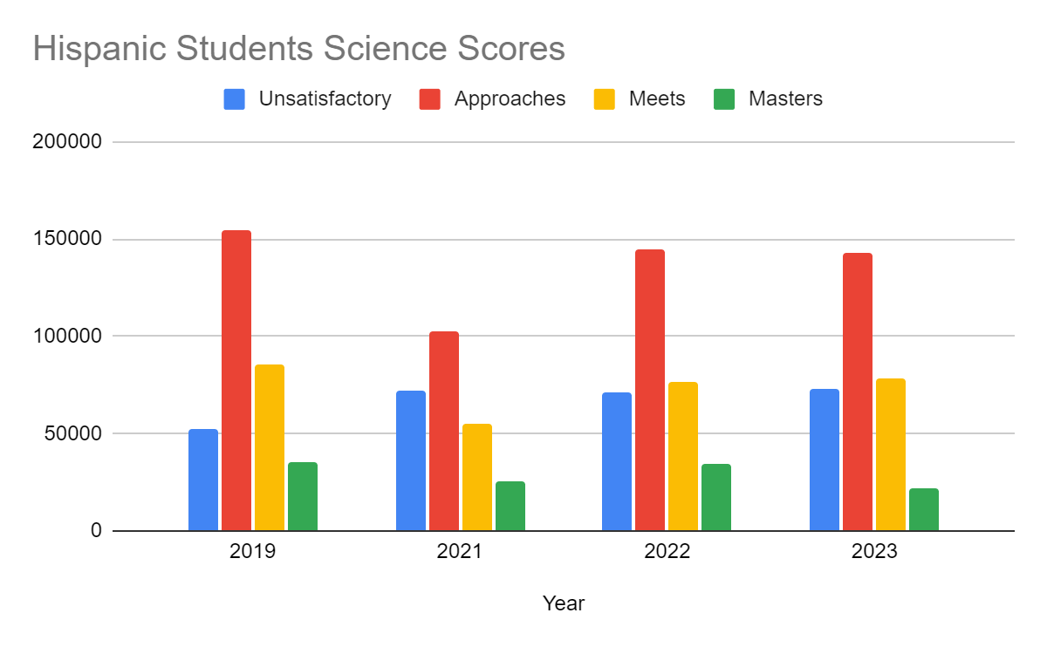
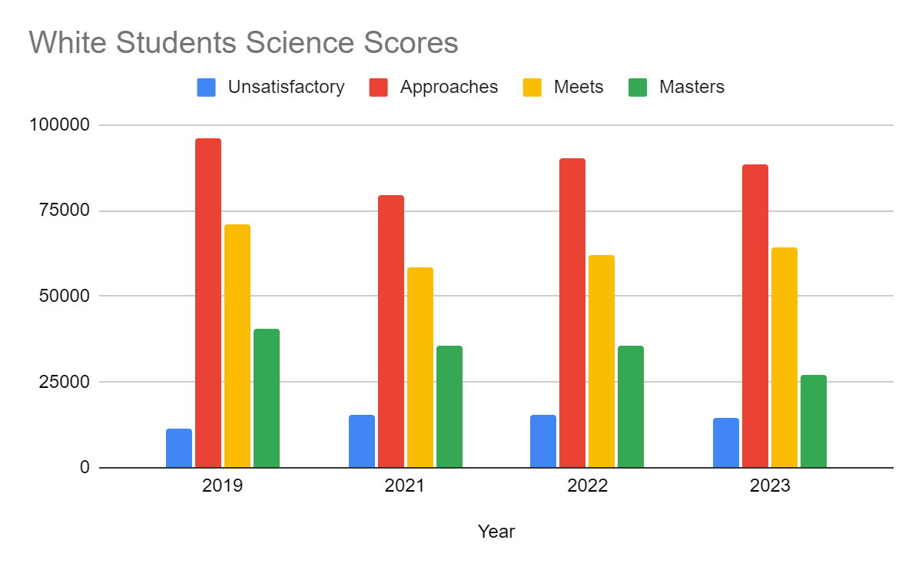
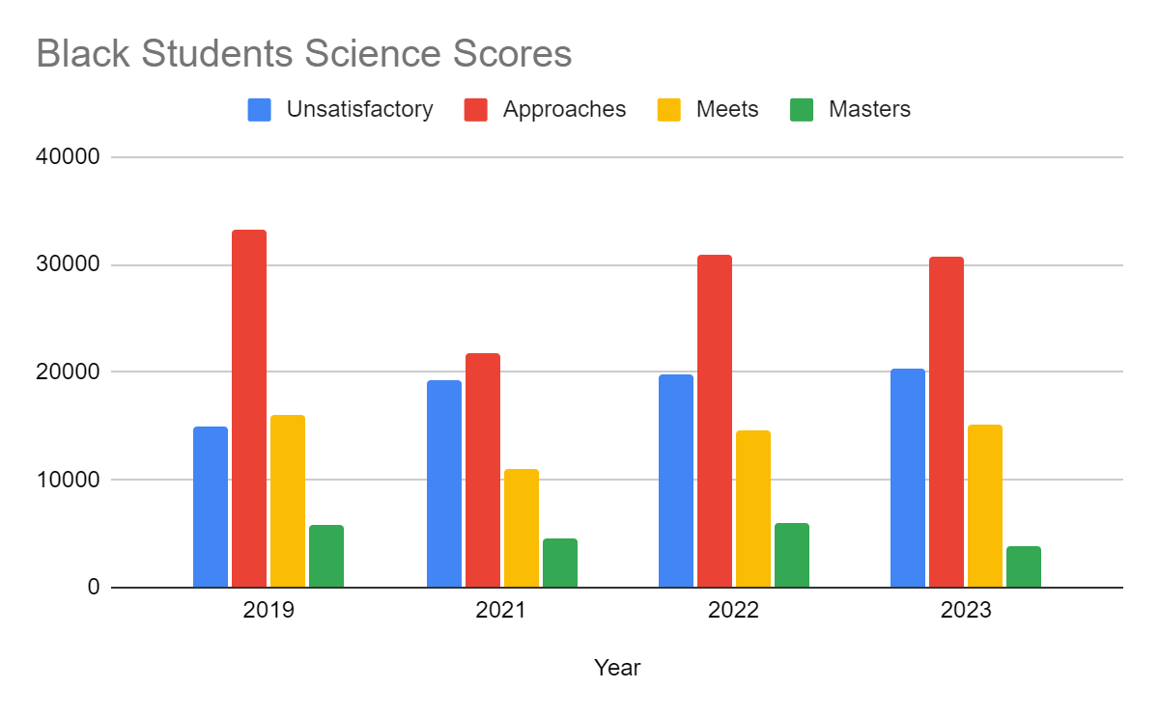
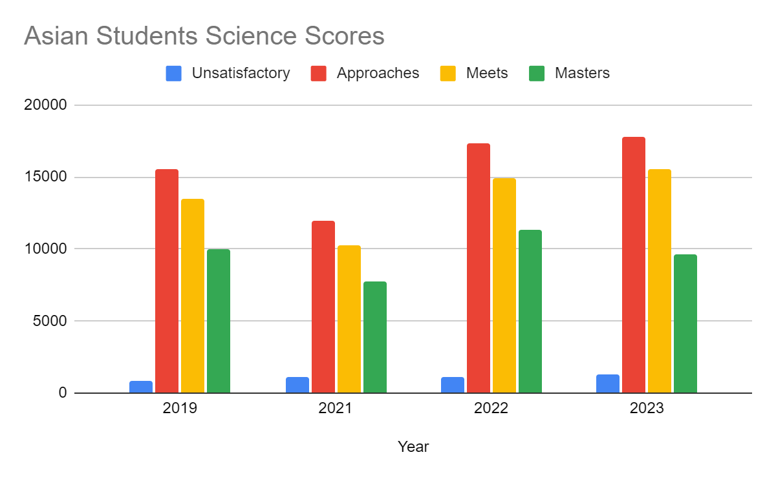
Science Findings

Slide 11
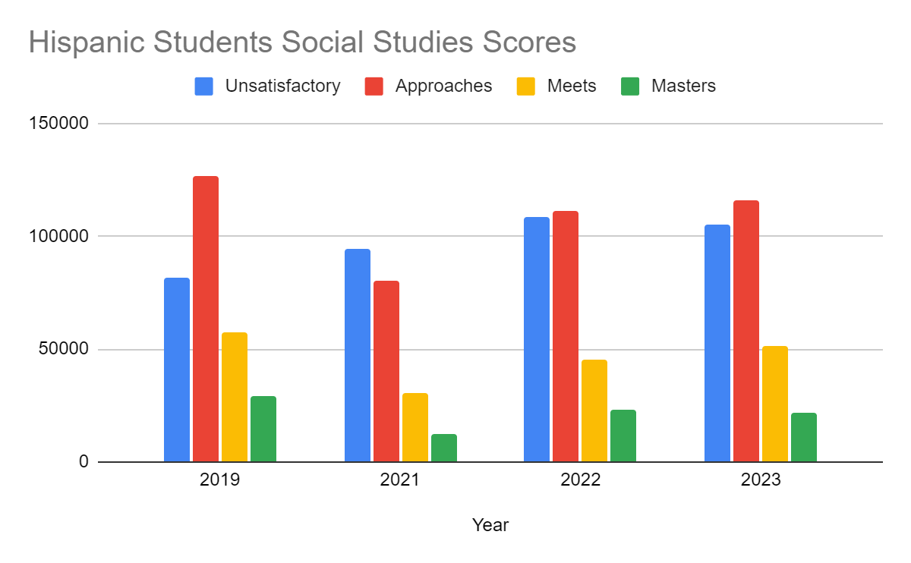
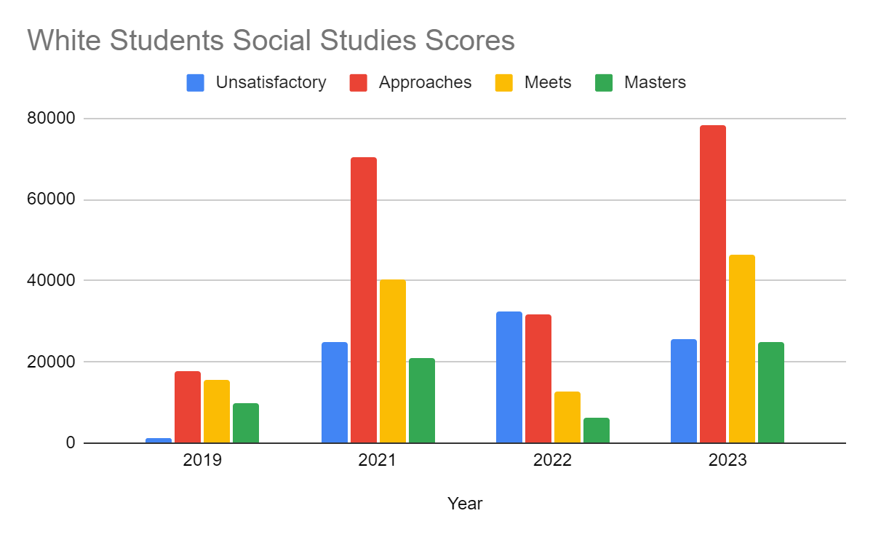
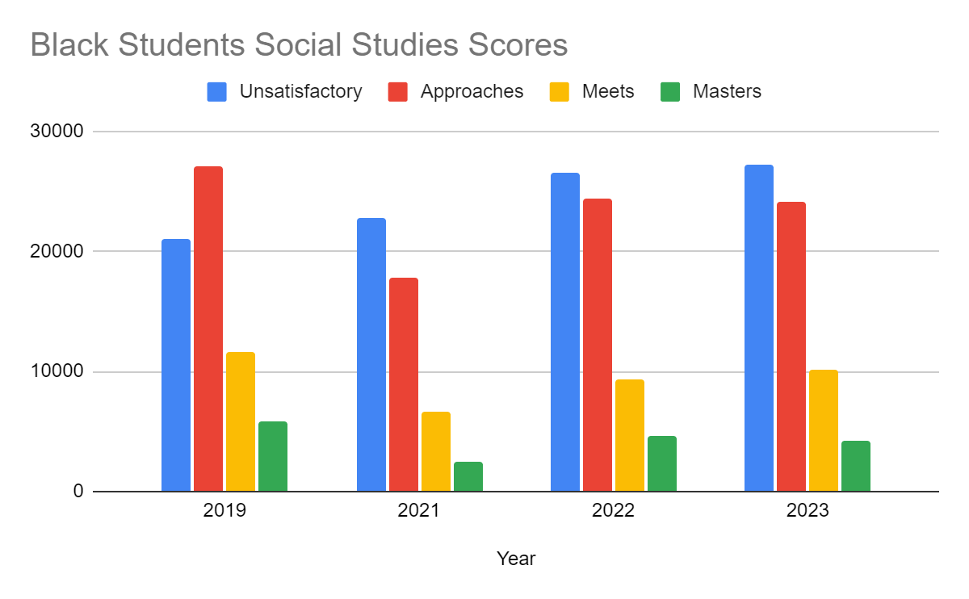
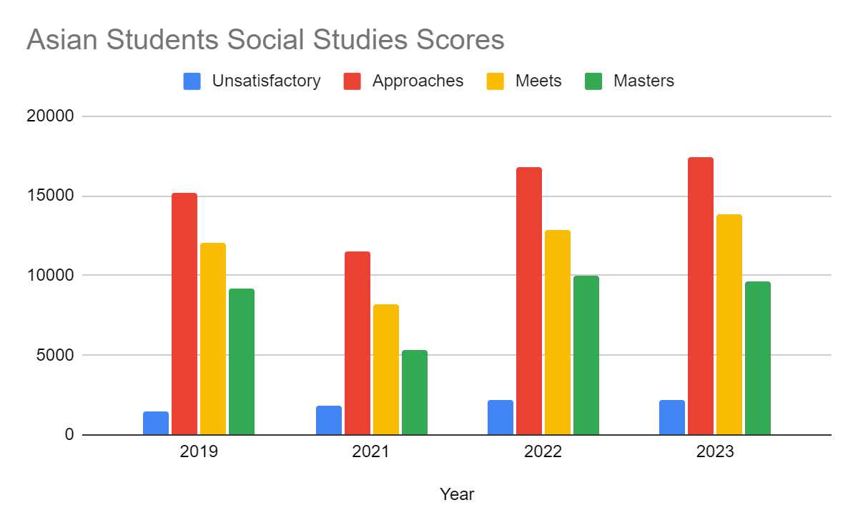
Social Studies Findings
Notes:
Pre Post
Black Students 10% 34.14 7% 44.09%(Unsatisfactory)
Hispanic 37.06% There was decline, then an improvement but they were not able to surpass pre pandemic levels.
The same can be said for white and Asian students.

Slide 12
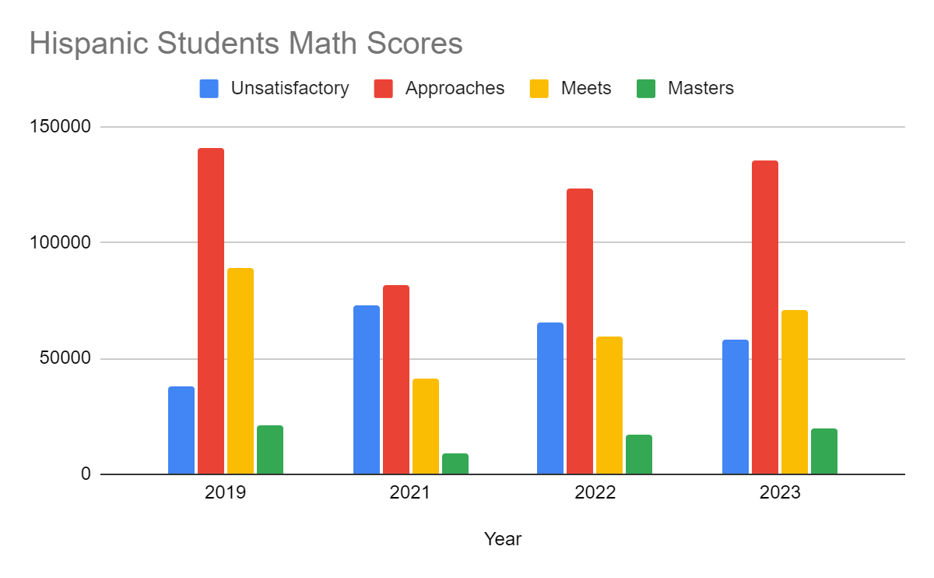
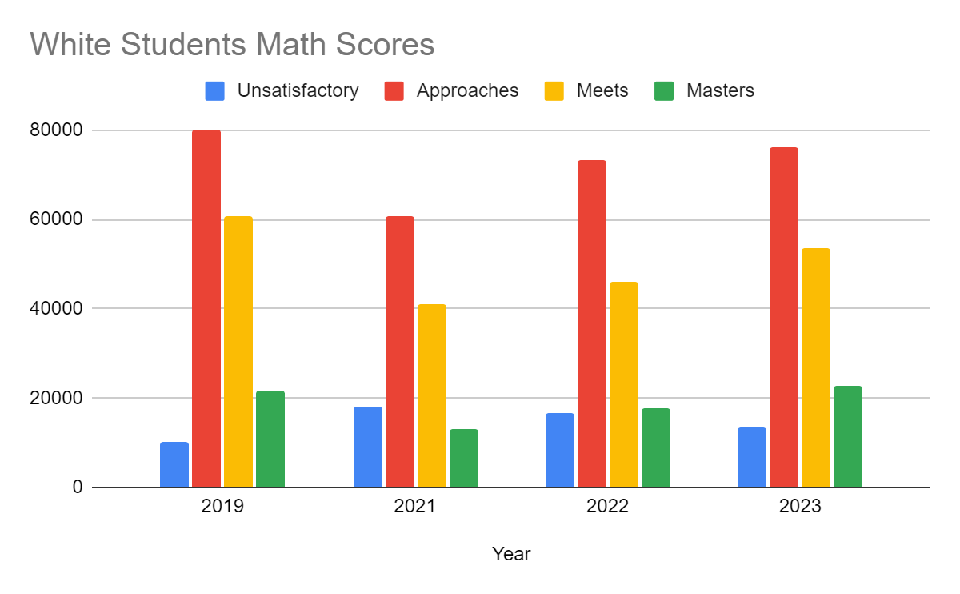
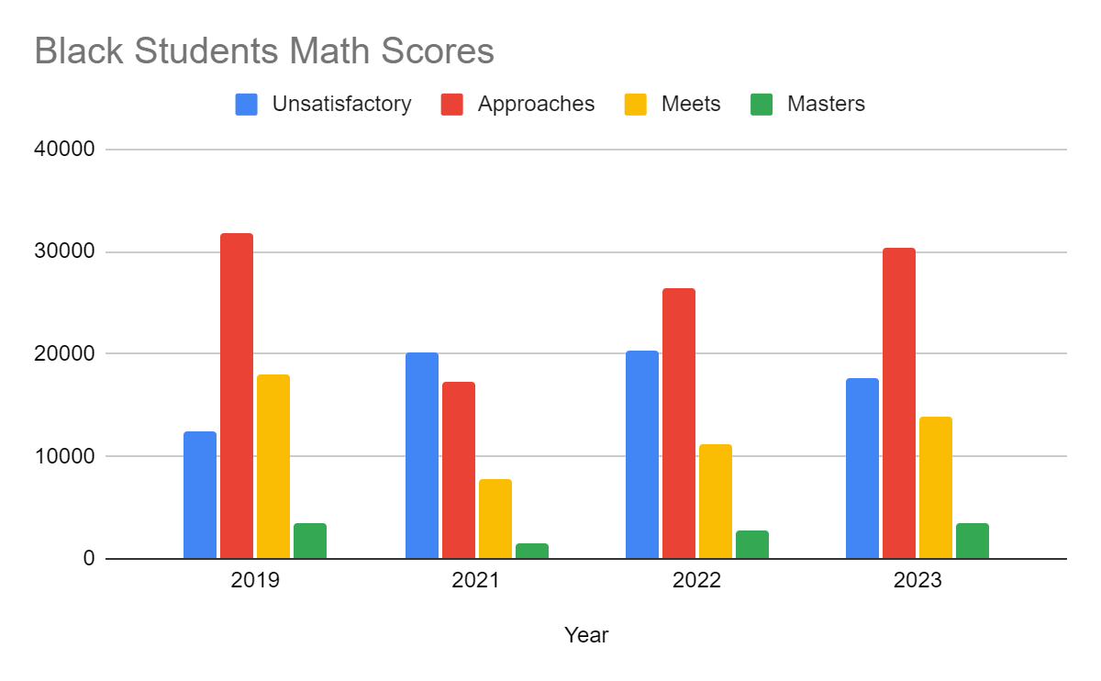
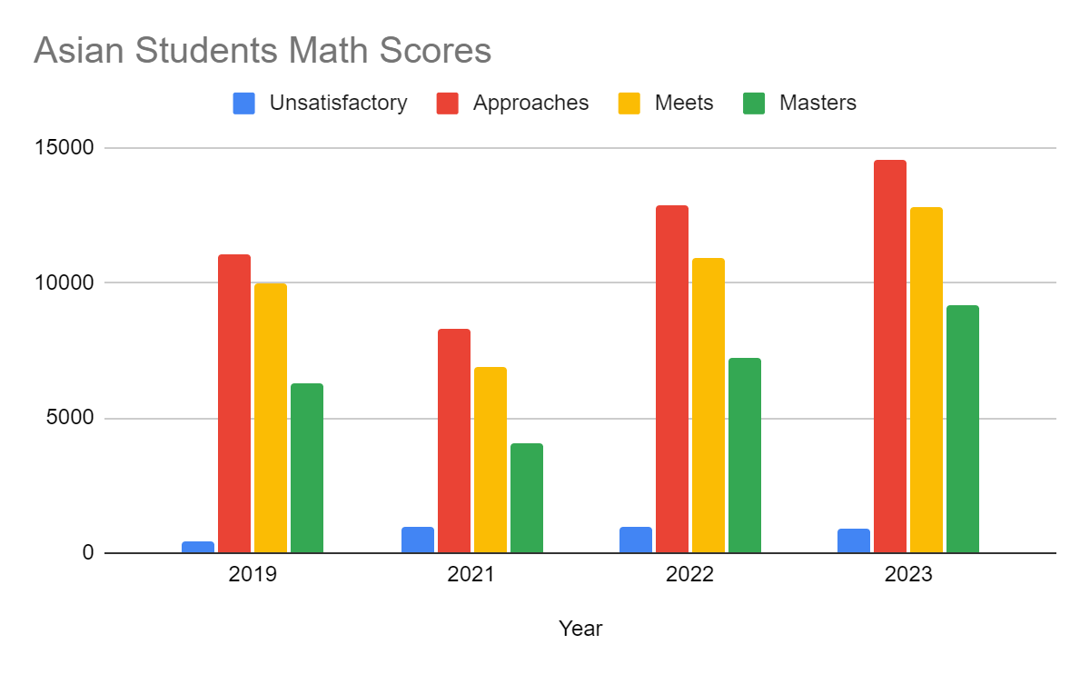
Math Findings
Notes:
Black students:The pandemic appears to have exacerbated the math gap, with only 18.31% of students receiving unsatisfactory results that did not meet grade level requirements in 2019. This percentage increased to about 41.44% in 2021. Despite marginal improvements, black students consistently had the highest number of students with subpar grades over all four years.
Hispanic:Despite constituting about half of the total student population, less than 10% of cohorts were able to master the concepts taught in mathematics.
Asian students comprised less than 10% of the total test takers in mathematics.They consistently had the highest percentage of students who mastered math across all four years, outperforming all other racial groups

Slide 13
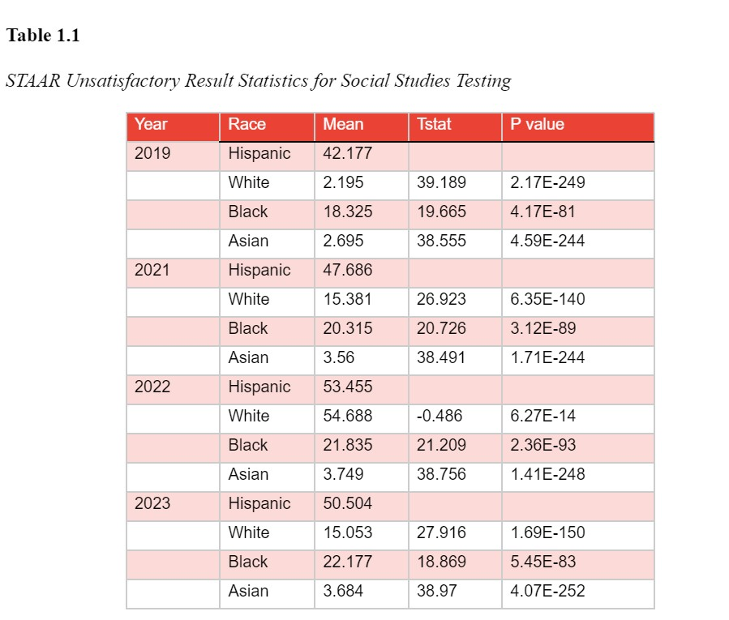
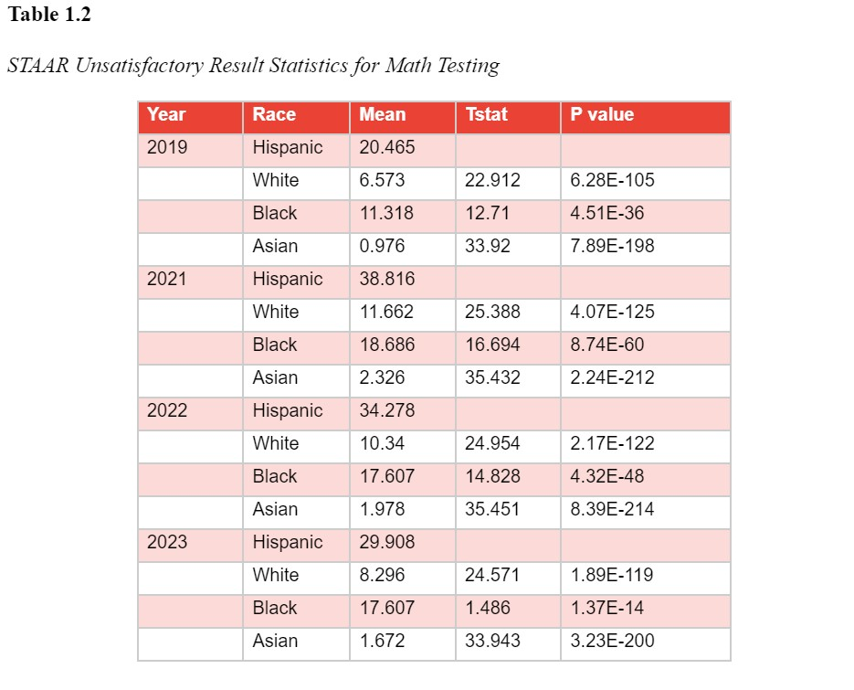
T Test
Notes:
Joel

Slide 14
Conclusion
Texas Education Initiative so far
Similar findings
NAEP
Overall Decline after COVID-19
Texas lags behind
Policy Recommendations
Equitable Funding
Impact analysis of policies
Modify curriculum
Instant faculty feedback
Discipline
Redressal mechanism
Notes:
As of 2022, the average test scores of Texas were less than the national average of 261.
Overall, only the White and Asian ethnic groups scored above the national average.
here was a decline in the average scores of all students across states in the US from 2019 to 2022.
The TEA (Texas Education Agency) had put forth a strategic plan : Reading Academies,Math innovation zones.

Slide 15
Future Research
Pandemic Response
How can we make up for the learning loss?
Focus on students that were most affected by this loss
Effects of Virtual Learning on Students
Look at all grade levels and different states
Notes:
Adam/Joel

